Slide 1
OXYSIM An Oxidation Simulator
Group-3:
Mukul Garg (MT19147)
Subodh Kumar Sharma (MT19161)
Chandraveer Singh (MT19177)
Puneet Kumar (MT19189)

Slide 2
Silicon Oxidation
What is Silicon Oxidation?
The process of creating silicon dioxide layer on the silicon surface
Why you need SiO2 over silicon?
Creates extremely high electronic quality gate oxides
Mask against implant or diffusion of dopant into silicon
Surface passivation
device isolation
electrical isolation of multi-level metallization systems

Slide 3
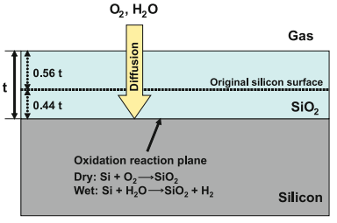
How to oxidize silicon?
Fig.1. The basic silicon oxidation process
Silicon dioxide is usually grown by consuming silicon during oxidation process at high temperature from 750 to 1100 ◦C

Slide 4
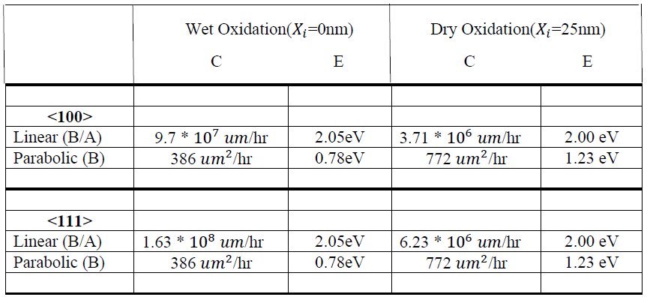
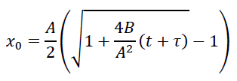

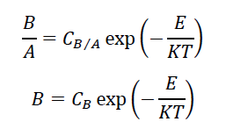
Deal-Grove Model
Oxide thickness
where
Table 1: The values of coefficients and activation energy depending upon orientation and oxidation type
Source: https://www.iue.tuwien.ac.at/phd/filipovic/node31.html#sect:dealgrove

Slide 5

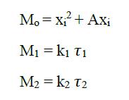
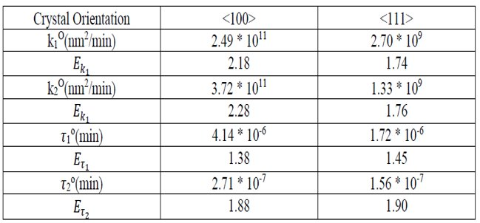
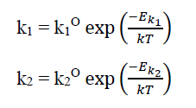
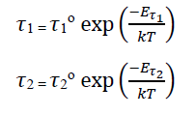
Massoud Model
Oxide thickness
where
Table 2: Arrhenius expression coefficients
Source: https://www.iue.tuwien.ac.at/phd/filipovic/node33.html#equ:massoud12

Slide 6
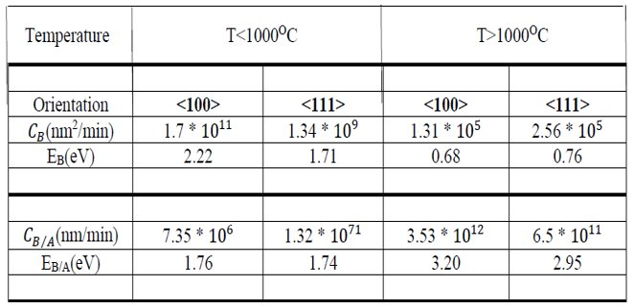


Massoud Model
Table 3: The values of coefficients and activation energies depending upon orientation, oxidation type and temperature
Source: https://www.iue.tuwien.ac.at/phd/filipovic/node33.html#equ:massoud12

Slide 7
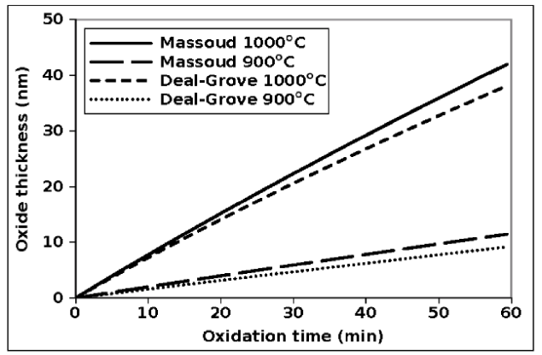
Comparison of Models
The Deal-Grove shows initial linear growth rate that becomes parabolic as oxide grows
The oxide growth is non-linear for oxide thickness of about 30 nm
The Massoud term is used to model the initial rapid oxide growth, accurately
Fig. 1: Comparison between the Deal-Grove and Massoud models for the oxide thickness during the first hour of oxidation in a dry ambient
Source: https://www.iue.tuwien.ac.at/phd/filipovic/node33.html#equ:massoud12

Slide 8
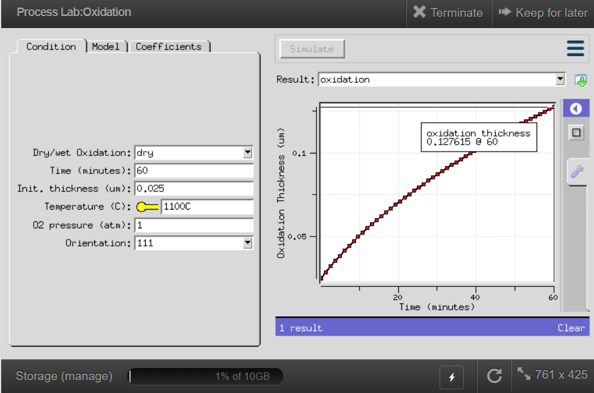
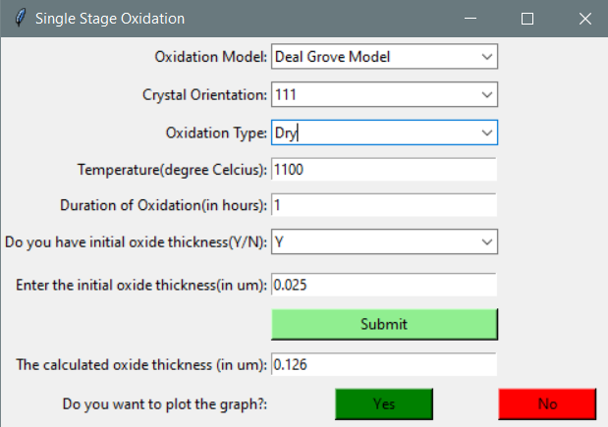
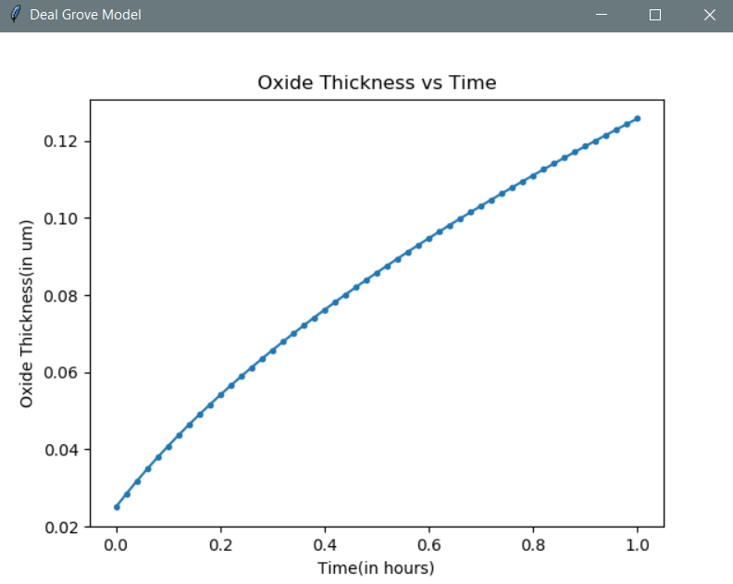
Verification
Source: https://nanohub.org/resources/prolabox
OXYSIM Results

Slide 9
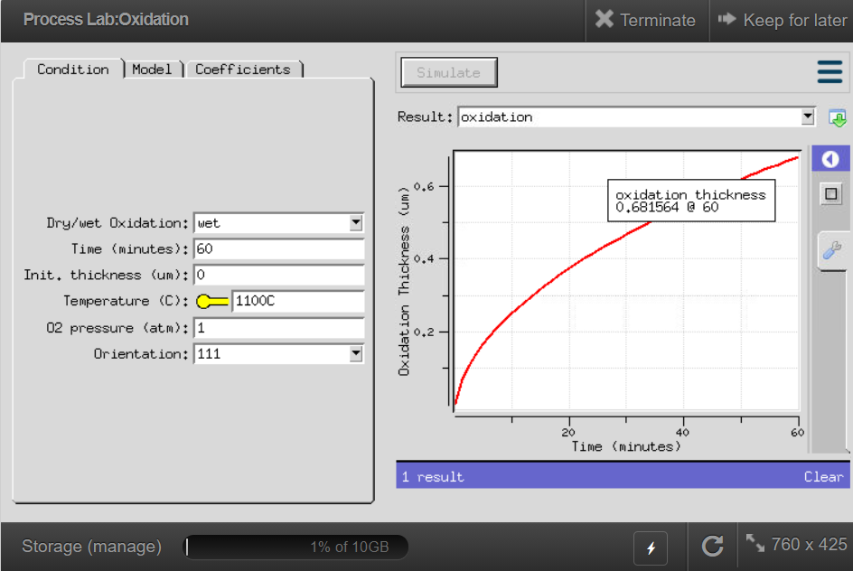

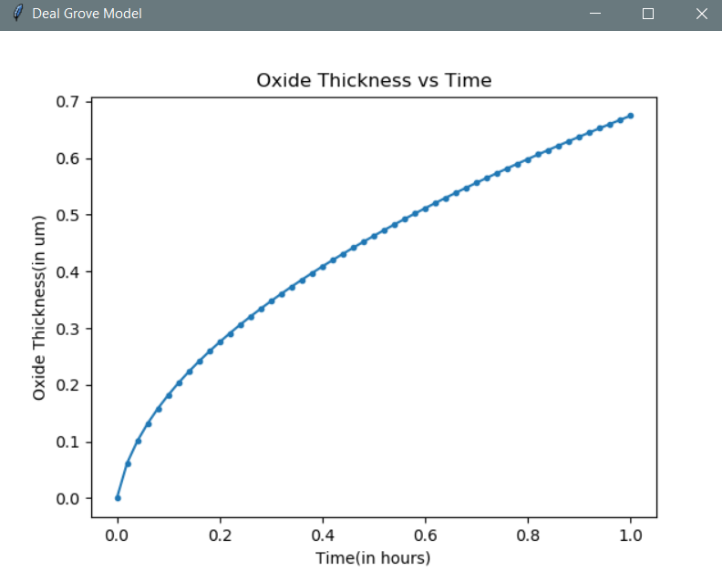
Verification
Source: https://nanohub.org/resources/prolabox
OXYSIM Results

Slide 10
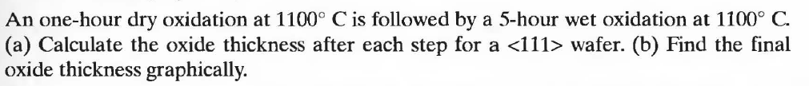
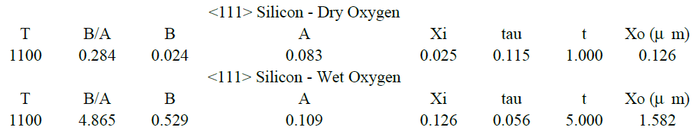
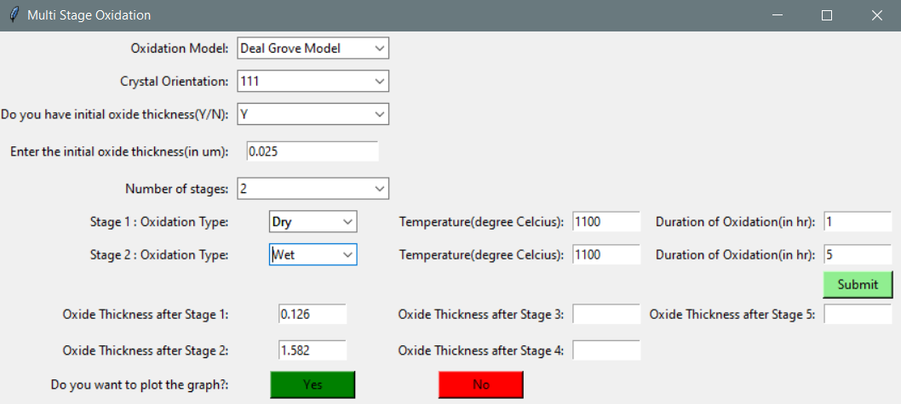
Verification

Slide 11

Tool Demo

